Slide 1
Maspa
Network = BW Meeting Room
User name = BW
Password = BW

Slide 2
Implicit Bias in Hiring
October 27, 2023
“I am convinced that nothing we do is more important than hiring and developing people. At the end of the day you bet on people, not on strategies.”
- Lawrence Bossidy, GE
Dr. Cheryl Butts
Executive Director, Human Resources
Taunton Public Schools
Taunton, Massachusetts

Slide 3
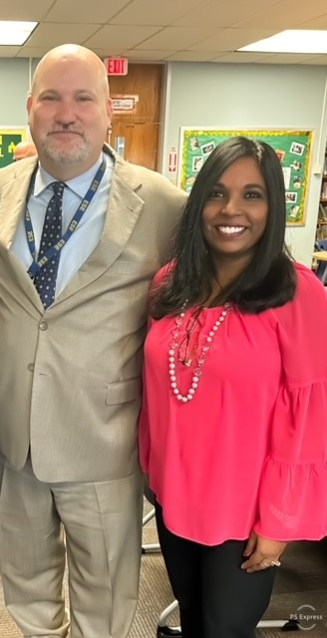
The Power of Implicit Bias and its impact on hiring
Human Resources responsible for placing highly qualified educators & support staff in classrooms
The Mental Health of our employees is important
Must do better to attract more people to K-12 education
Grow your own – pipeline
Student internships
Retention strategies
“Listening without bias or distraction is the greatest value you can pay another person”
- Denis Waitley
Notes:
There are two major forms of bias (explicit and implicit). Bias can
be generally defined as an automatic, usually unconscious and
unintentional, inclination, preference, or favoring of a given individual
or group over another. It is the brain’s way of sorting,
categorizing, and/or prioritizing interacting with individuals or
groups.

Slide 4
The Power of Implicit Bias and its impact on hiring
Ground Rules
Respect differences and another’s idea
Share your experiences
Listen constructively and respectively
Recognize that even if we don’t agree with it, each of us is entitled to our own perspective
Keep confidences and assume others will
Relax and be yourself!
Have fun! I know I will!
“Good Leadership requires you to surround yourself with people of diverse perspectives
who can disagree with you without fear of retaliation” - Doris Kearns Goodwin
Notes:
There are two major forms of bias (explicit and implicit). Bias can
be generally defined as an automatic, usually unconscious and
unintentional, inclination, preference, or favoring of a given individual
or group over another. It is the brain’s way of sorting,
categorizing, and/or prioritizing interacting with individuals or
groups.

Slide 5
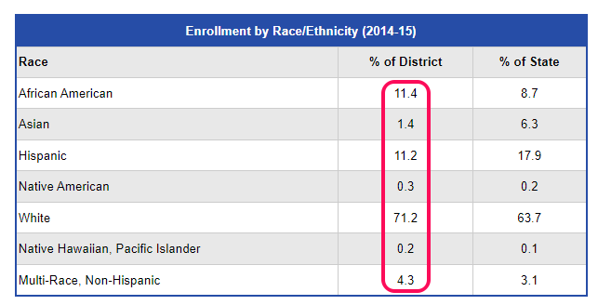
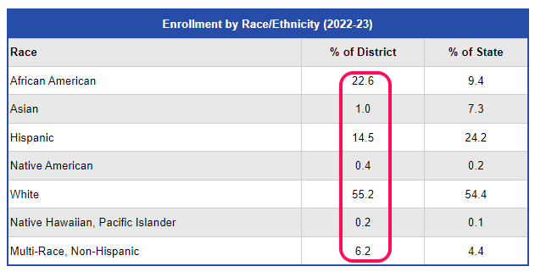
The Power of Implicit Bias and its impact on hiring
Department of Elementary and Secondary Data
“Companies that embrace diversity and inclusion in all aspects of their business statistically
outperform their peers” - Josh Bersin
-
Notes:
There are two major forms of bias (explicit and implicit). Bias can
be generally defined as an automatic, usually unconscious and
unintentional, inclination, preference, or favoring of a given individual
or group over another. It is the brain’s way of sorting,
categorizing, and/or prioritizing interacting with individuals or
groups.

Slide 6
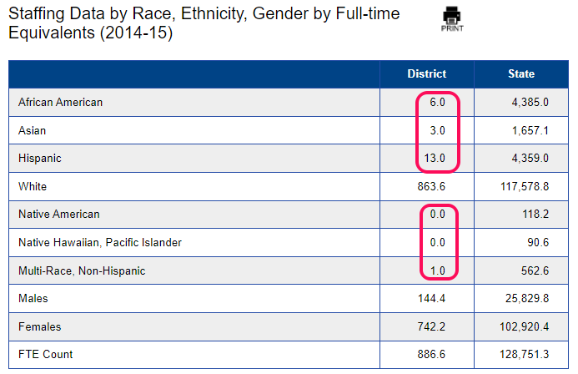
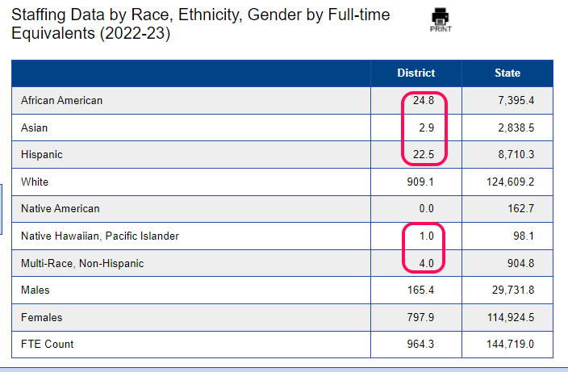
The Power of Implicit Bias and its impact on hiring
Department of Elementary and Secondary Data
“Great leaders do what is right not what is easy” - Unknown
Notes:
There are two major forms of bias (explicit and implicit). Bias can
be generally defined as an automatic, usually unconscious and
unintentional, inclination, preference, or favoring of a given individual
or group over another. It is the brain’s way of sorting,
categorizing, and/or prioritizing interacting with individuals or
groups.

Slide 7
The Power of Implicit Bias and its impact on hiring
Lilly Singh …….
“If you have a brain you have bias” - Unknown
Notes:
There are two major forms of bias (explicit and implicit). Bias can
be generally defined as an automatic, usually unconscious and
unintentional, inclination, preference, or favoring of a given individual
or group over another. It is the brain’s way of sorting,
categorizing, and/or prioritizing interacting with individuals or
groups.

Slide 8
The Power of Implicit Bias and its impact on hiring
Introduction
Implicit Bias can affect all stages of a district’s hiring process, from the initial resume review to the final decision. In the K-12 world, lack of awareness of stereotyping could be one reason for the districts that have made little progress in diversifying their work forces.
If school districts do not evaluate whether or not their hiring process is fair to everyone, people of color and other minorities may never get a fair shot to work for them.
“It doesn’t make sense to hire smart people and tell them what to do; we hire smart people
so they can tell us what to do.” - Steve Jobs
Notes:
There are two major forms of bias (explicit and implicit). Bias can
be generally defined as an automatic, usually unconscious and
unintentional, inclination, preference, or favoring of a given individual
or group over another. It is the brain’s way of sorting,
categorizing, and/or prioritizing interacting with individuals or
groups.

Slide 9
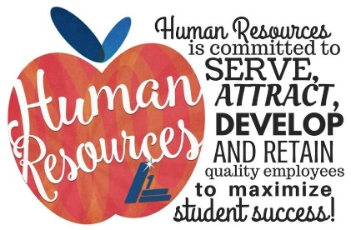
The Power of Implicit Bias and its impact on hiring
Agenda
Historical View
What is Implicit Bias
Lived experiences – share with us
Bias in hiring - Video
How to reduce bias in the hiring process
What can you do
Harvard Implicit Association Test (IAT)
Good reads
In recruiting, there are no good or bad experiences – just learning experiences!

Slide 10
The Power of Implicit Bias and its impact on hiring
Today in the US
A demographic divide exists between students of color and non white teachers in urban districts
Nationally, 82% of teachers are White
In Massachusetts, 97% of teachers are White
Where are all the teachers of color?
Administrators of color?
“Time spent on hiring is time well spent!” - Robert Half

Slide 11
The Power of Implicit Bias and its impact on hiring
Historical Background
US Supreme Court ordered schools to integrate in 1954
Black students were assigned to formerly White schools
Tens of thousands of Black teachers and principals lost their jobs
In the 1970s and 1980s states introduced certification exams
By 2014 in US we only had 7% of Black teachers and 8% Latinx teachers, even less Indigenous teachers
THIS IS A SYSTEMIC ISSUE!
“Hire an attitude, not just experience and qualification.” - Greg Savage

Slide 12
The Power of Implicit Bias and its impact on hiring
Definition of Implicit Bias
Bias is a prejudice in favor of or against one thing, person, or group compared with another usually in a way that’s considered to be unfair. Biases may be held by an individual, group, or institution and can have negative or positive consequences
- The University of California – San Francisco's Office
of Diversity and Outreach
“ Innovation distinguishes between a leader and a follower.” - Steve Jobs

Slide 13
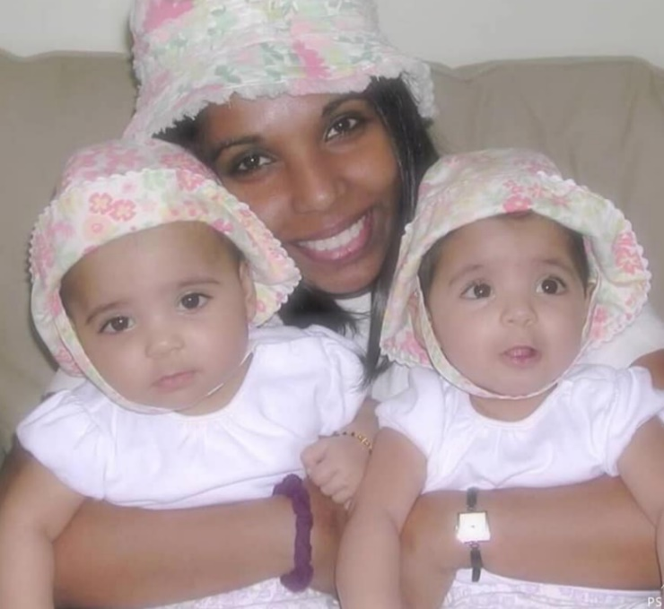
The Power of Implicit Bias and its impact on hiring
Lived Experiences
“ Experience is the best teacher!” - Unknown

Slide 14
The Power of Implicit Bias and its impact on hiring
Lived Experiences
“ Fill your life with experiences, not things. Have stories to tell, not stuff to show.”

Slide 15
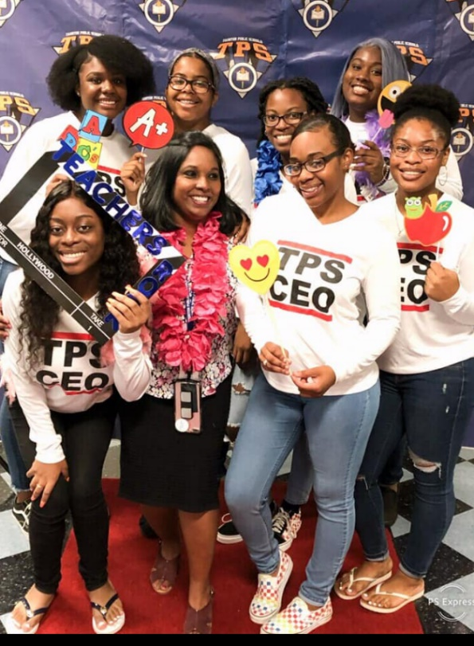
The Power of Implicit Bias and its impact on hiring
Lived Experiences
“ You can’t truly understand something until it happens to you. The meaning of life is
discovered In the experience.” - Unknown

Slide 16
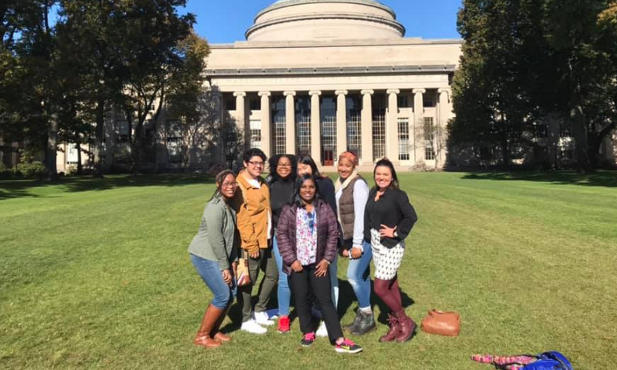
The Power of Implicit Bias and its impact on hiring
Lived Experiences
“ Because we all come from different circumstances, our life experiences really color
how we view things.” - Octavia Spencer

Slide 17
The Power of Implicit Bias and its impact on hiring
“ Education is the most powerful weapon which you can use to change the world.”
- Nelson Mandela

Slide 18
The Power of Implicit Bias and its impact on hiring
Types of Bias
Skin color, gender and age are generally what people think of when they consider biases, but individuals can harbor unconscious prejudice about myriad characteristics, including:
Height and weight
Colorism – skin tone
Marital and parental status
Disability status (for example, the use of a wheelchair or cane)
Foreign accents
Where someone attended college
Hobbies or extracurricular activities
“We don’t see things as they are we see things as we are.” – Anais Nin

Slide 19
The Power of Implicit Bias and its impact on hiring
Questions to ask yourself:
Do I typically hire similar types of people or people who are like me?
What do I mean when I say a candidate is not the right fit?
What can I learn about my past hiring choices, both successful and unsuccessful?
Who do I include in important meetings and events?
How do I identify and choose candidates for promotion and succession?
“We need diversity of thought in the world to face the new challenges”
- Tim Berners-Lee

Slide 20
The Power of Implicit Bias and its impact on hiring
Steps to reduce bias in hiring practices
Reach out to minorities – circulate job announcements to email lists and websites with significant minority membership or readership. We need to be actively building relationships with communities of color, even before the job becomes available.
Build deeper relationships with organizational and alumni groups that serve people of color. As people in leadership roles we need to expand our personal and professional circles. Get out of your comfort zone!
Remove race from the resume review process – block out names and don’t look at photos. You’ll be surprised how many more candidates of color will make it past the review stage. You will start looking for someone’s experience in a more objective way.
“When we increase our cultural intelligence we begin to identify our biases.”
- Unknown

Slide 21
The Power of Implicit Bias and its impact on hiring
Steps to reduce bias in hiring practices – Cont’d
Have standard interview questions – do not be informal as this can lead to bias, as hiring managers act more warmly toward candidates they unconsciously prefer and this can affect their judgement.
Set criteria for the final recommendation – it helps to have a standard scoring system for candidates that is as objective as possible. A rubric can help by spelling out what interviewers are going to assess.
Keep evaluating your bias at each stage of the hiring process – from the initial job posting through the interviews and the final recommendation.
Get honest feedback from colleagues and peers regarding your actions and behaviors in the workplace.
“If you don’t like something, change it. If you can’t change it, change your attitude.”
- Maya Angelou

Slide 22
The Power of Implicit Bias and its impact on hiring
Steps to reduce bias in hiring practices – Cont’d
Consider people who are less extroverted or who have had fewer opportunities to demonstrate their capabilities.
Reduce the influence of your peers’ opinions on your hiring decisions.
Use the “flip it test” – Ask yourself if you were to swap out the underrepresented candidate with someone who you would typically hire, would you still react the same way?
“If your actions inspire others to dream more, learn more and become more, you are
a leader.” - John Quincy Adams

Slide 23
The Power of Implicit Bias and its impact on hiring
https://implicit.harvard.edu/implicit/takeatest.html
“To handle yourself, use your head; to handle others, use your heart.” - Eleanor Roosevelt

Slide 24
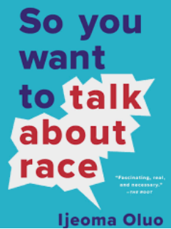
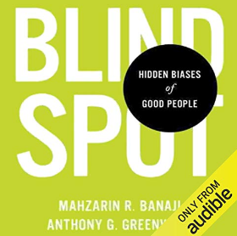
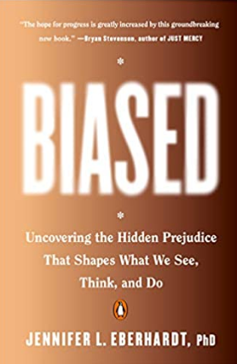
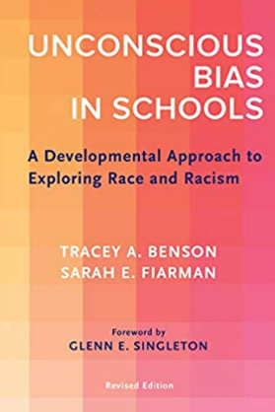
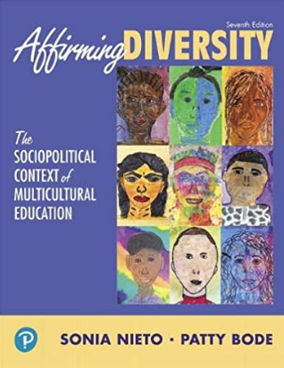
The Power of Implicit Bias and its impact on hiring
“We need diversity of thought in the world to face the new challenges.”
- Tim Berners-Lee

